Slide 1

FIT-X
Calorie Tracking System
Team Members:
Arjun R-224027019
Barathvaj K-224027032
Vengatesh B-224027172

Slide 2
ABSTRACT:
A Calorie Tracking Website which helps the users to track their calorie intake and suggest which amount of bodyweight is good for their health.
User login gathers critical information: current weight, goal weight, height, active level, and weekly goals.
Utilizes HTML, CSS, and JavaScript for an intuitive caloric intake management web application.
Backend integration with MySQL Workbench and Node.js ensures robust data storage and retrieval.

Slide 3
SOFTWARE USED
Front-end
HTML,CSS,JS
Server-side
node js
Database
MySQL

Slide 4
SOFTWARE REQUIREMENTS
Chrome
Microsoft Edge
HARDWARE REQUIREMENTS
Intel i3 5thGen/AMD Ryzen 3
RAM 512

Slide 5
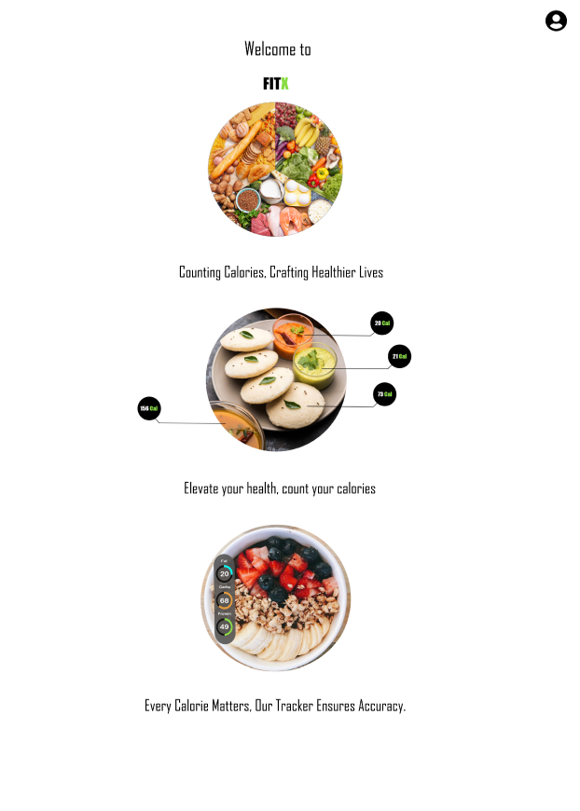
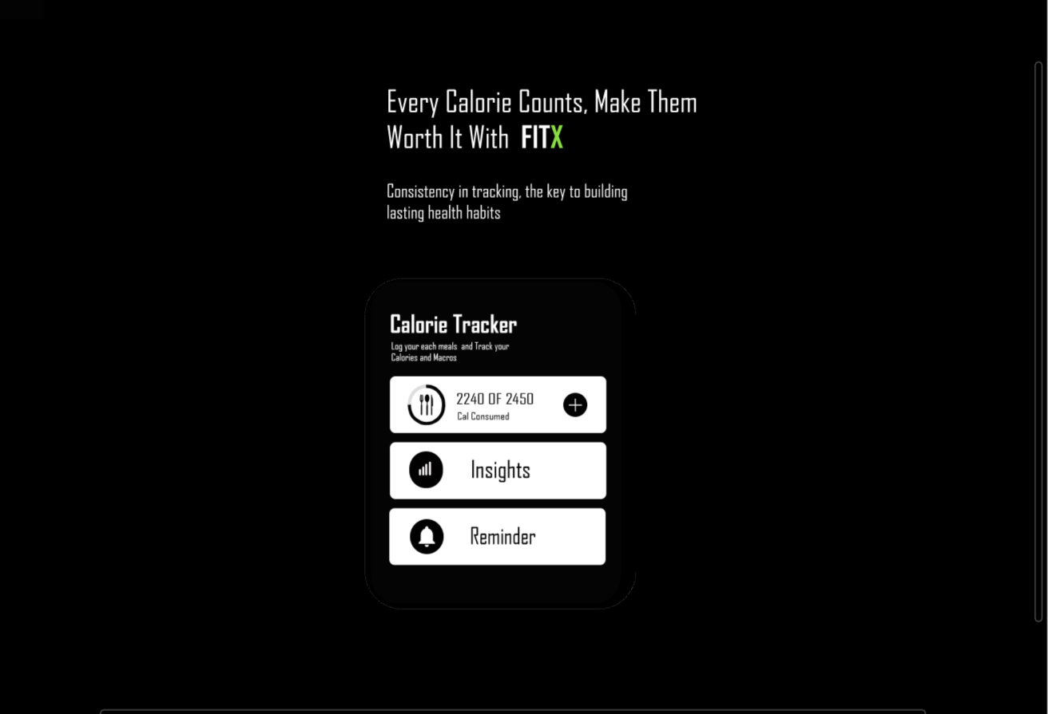
FRONT-END DESIGN LAYOUT

Slide 6
THANK YOU

